Slide 1
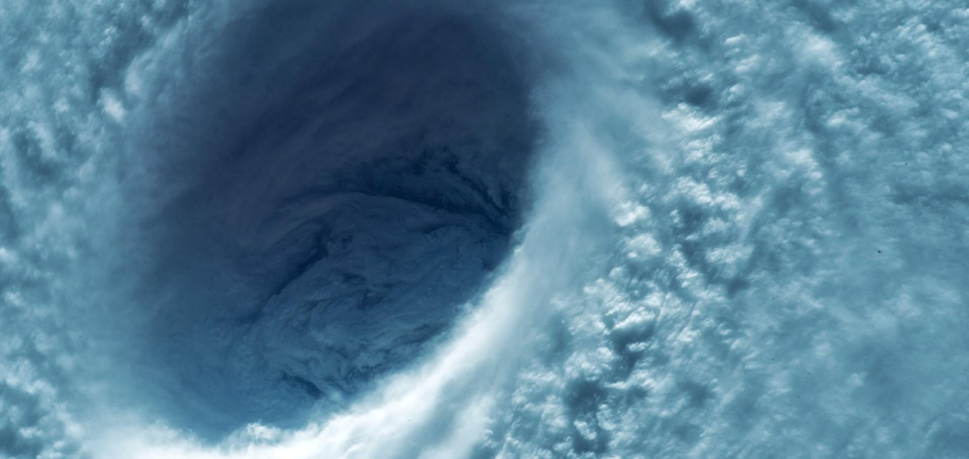

Hurricane
Tabletop Exercise
Presenter Name
First.Last@AgilityRecovery.com
XXX-XXX-XXXX

Slide 2
Agenda
1
Introduction
2
About a tabletop
3
The learning exercise
4
After-action discussion

Slide 3

About Tabletop
  Tabletop Exercises are designed to help ensure that your program and plans can be effectively executed and that all participants understand their roles.
  This is your opportunity to validate that your plans will enable the firm to effectively continue business in the short-term and then efficiently recover and return to business as usual.

Slide 4
Exercise Objectives
Coordination: Improve coordination among the various members of the Crisis Team.
Communications: Evaluate the communication process among team members and with other groups.
Decision Making: Assess the decision-making processes and activation of the team.

Slide 5
Guiding Principles
Training and learning exercise – not a test!
There are no “hidden agendas” or trick questions.
It’s not about the scenario; it’s about the response.
There are no single or simple solutions.
Open and interactive discussion–there may be more than one response to the crisis.
The end goals:
  Understand the process
  Identify gaps
  Develop team readiness to respond

Slide 6
Questions

Slide 7
Hurricane Scenario at:
Name of location goes here
[company location]
[specific building]

Slide 8
Current Conditions
Date: August 15
[company name] has been closely monitoring Tropical Storm Paula. The storm has been gaining strength and is predicted to develop into a hurricane.

Slide 9
The Incident Begins
On August 30, the National Weather Service issues a statement predicting Tropical Storm Paula has the potential to develop into a hurricane.
The initially predicted storm path indicates your office may be at risk.

Slide 10
Based on This Information
Should you be concerned?
What actions should be taken next?
How are you communicating with employees?
Who is communicating?
Who is responsible for monitoring the storm situation?

Slide 11
Update
On August 19, Tropical Storm Paula is upgraded to a hurricane and appears to present a threat to your location.
Later that day, the Governor announces an Emergency Declaration and advises residents in the area to evacuate inland.

Slide 12
Based on This Information
What business decisions need to be
made at this point?
Who will make these decisions?
What resources are you using to monitor the storm?
How will you communicate with your employees? Your clients?

Slide 13
Update
Based on the voluntary evacuation order from the Governor, [company name] decides to suspend normal business operations at the [location] office.
Evacuation shelters have been established in the area. Fourteen employees have evacuated inland.

Slide 14
Based on This Information
What is [company name]’s involvement in providing recommendations for employees to evacuate?
How will the decision to suspend operations be communicated to clients?

Slide 15
Update
On August 21, Hurricane Paula makes landfall at [near location, but not direct] as a Category 2 hurricane.
As a result of the 110mph wind gusts, your office has lost power.
Local cellular towers were also destroyed by the high winds and may be out for several days.

Slide 16
Based on This Information
?
?
?
?
Who is responsible for ensuring employees
are accounted for?
What is the role of the Crisis Leader?
Crisis Manager? Executive Crisis Team?
What are your concerns, given the situation?
How will you communicate with employees?
?
?
?
?
?
?

Slide 17
Update
Two days after the hurricane, of the 14 employees that evacuated, five have not yet returned.
Nine employees report significant damage
to their homes.
Your office building did not suffer any structural damage from the hurricane winds.

Slide 18
Based on this information
How will you determine when to
continue normal business operations?
When will you expect employees to return to work?
    How will you take into account situational circumstances?

Slide 19

Event Continues
The heavy rainfall following Hurricane Paula results in severe flooding in and around your office location.
Some parts of your office suffer water damage. It will be several weeks before carpet and ceiling tiles can be replaced.

Slide 20
Based on This Information
Do you have sufficient resources on site or elsewhere
available for your business to carry out essential functions?
    What are the required resources?
    What are the essential functions?
    How severe does the damage have to be to move operations to another building?
At what point do you activate your off-site computer back-up and/or stand-by computer resources?

Slide 21
Update
Two weeks after Hurricane Paula, normal business operations resume at [company name].
Later in the week the National Weather Service projects Tropical Storm Quentin has the potential to become a hurricane and may affect your area.

Slide 22

Additional Considerations
Hurricane-force winds and flooding are the greatest structural threats during a hurricane. Are you prepared for the possibility of flooding in your office?
Because of power outages and potential flooding, it may be unreasonable to expect employees to have access to the internet.

Slide 23
Additional Considerations, cont’d.
Hurricanes impact people differently: some may be able to return to work the next day, others may be homeless. In the aftermath of a severe hurricane, it is important to work with employees to determine the best course in moving forward.
It does not take a Category 5 hurricane to disrupt normal business operations, even small events may have large consequences.

Slide 24
After Action — How Did You Do?
List at least three things that the team did well during this exercise.
List any gaps you recognized.
List three action items to implement that will improve your ability to effectively respond.

